Slide 1
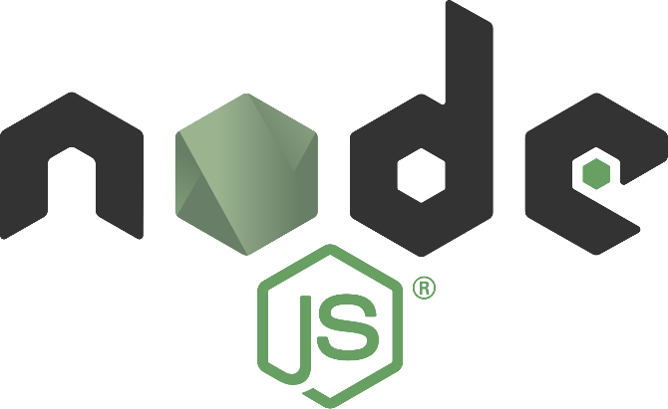
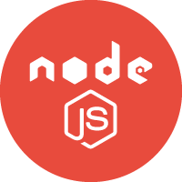

Node JS
Notes
Made By: Abdul Hafeez
www.codehafeez.blogspot.com

Slide 2
Basic Information – Node JS
Node JS Developed by Ryan Dahl in 2009
Node.js is an open source server environment.
Node.js allows you to run JavaScript on the server.
It allow run thing on Server Side. (Advance feature of JS)
Single Threads
It mostly use in single page application (Not reload / buffering)
npm install mongodb
npm install mongodb

Slide 3
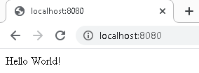
Example - 01
var http = require('http'); http.createServer(function (req, res) { res.writeHead(200, {'Content-Type': 'text/plain'}); res.end('Hello World!'); }).listen(8080);
RUN CMD Command => node example1.js
RUN URL => http://localhost:8080/

Slide 4
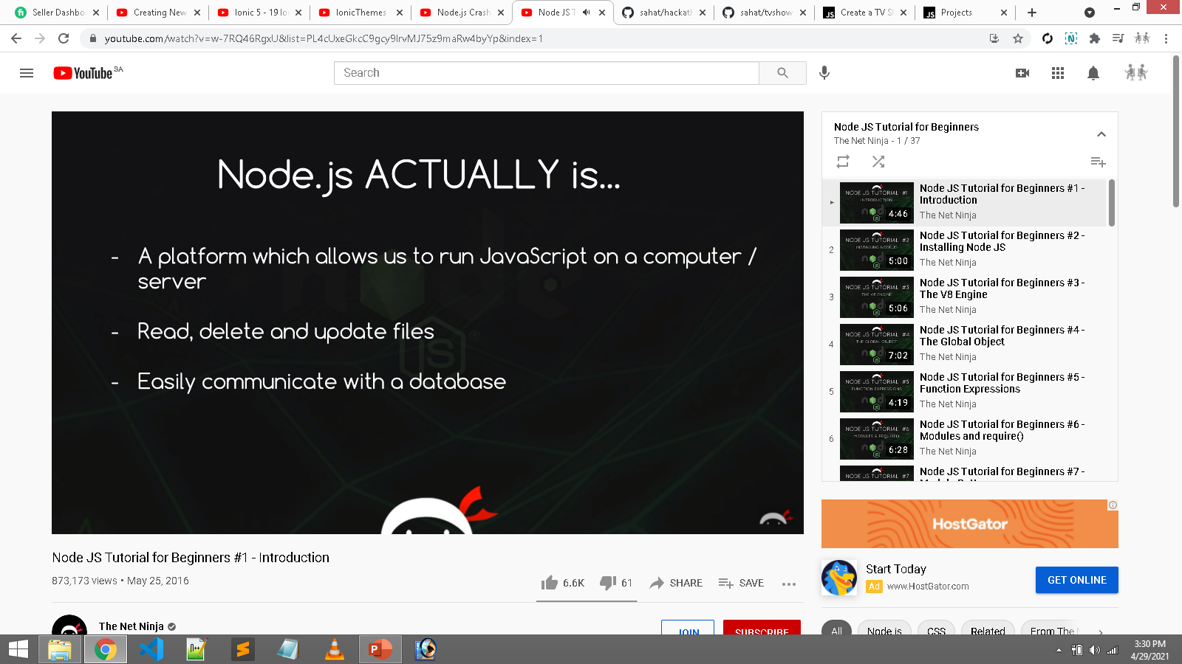

Slide 5
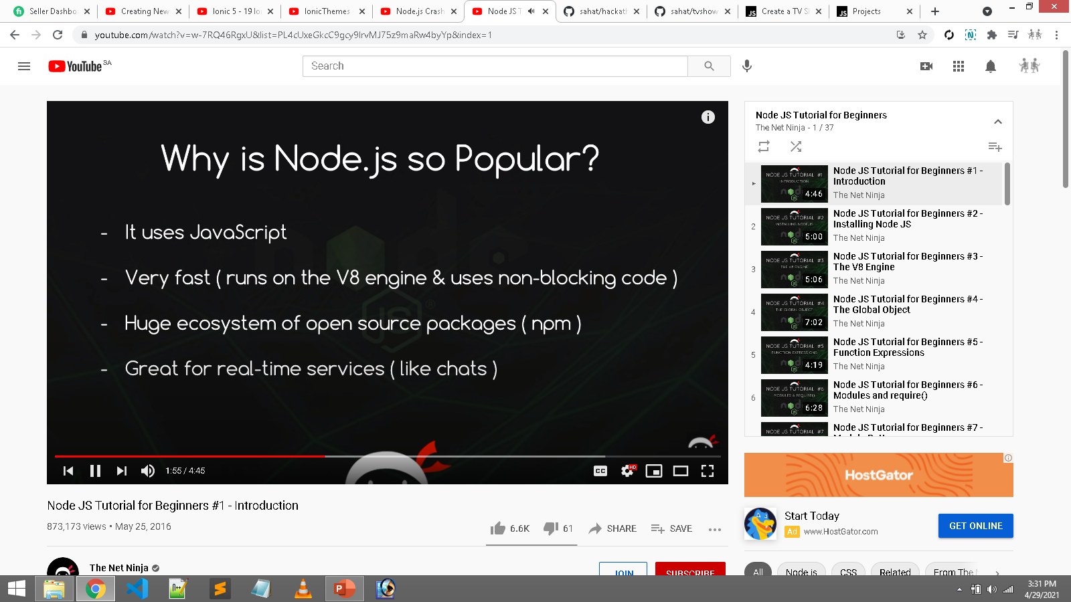

Slide 6
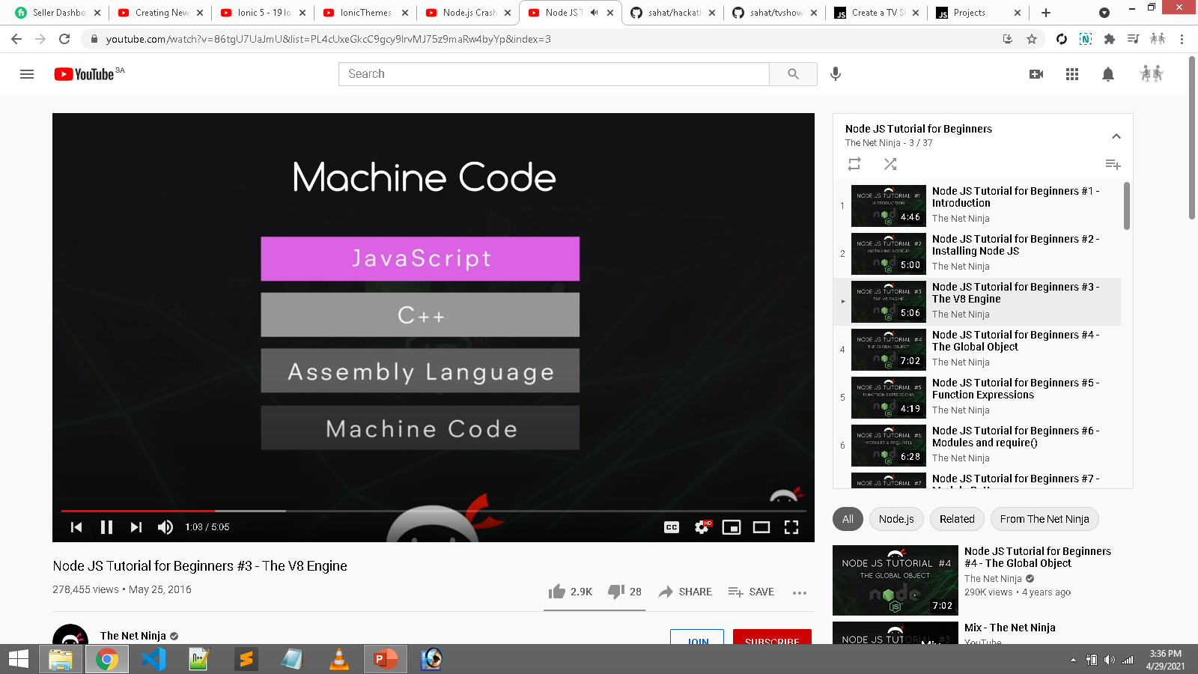
Node JS written in C++ Language.

Slide 7
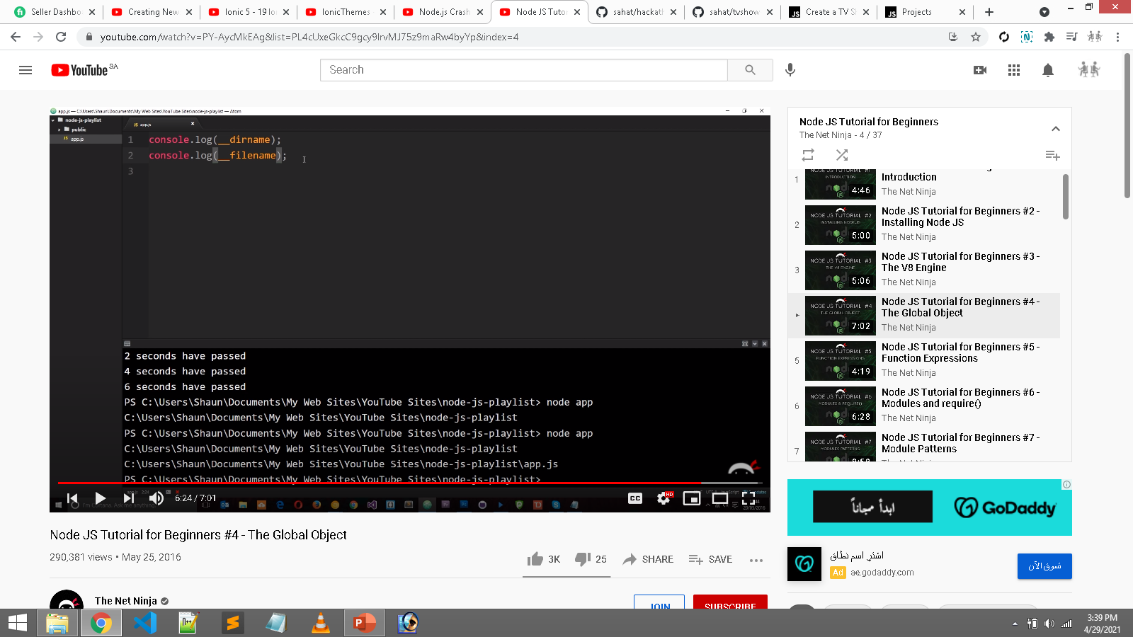
Code => Directly app
Code => Directly app file

Slide 8
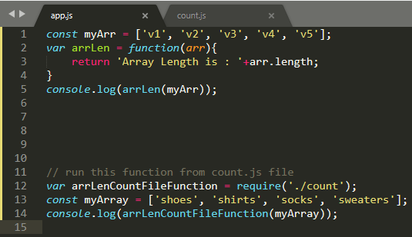
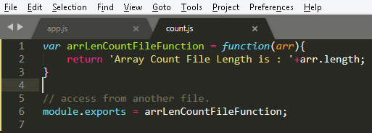

Example Array Using
Require & User Define Function
Example - 01
Simple Function

Slide 9
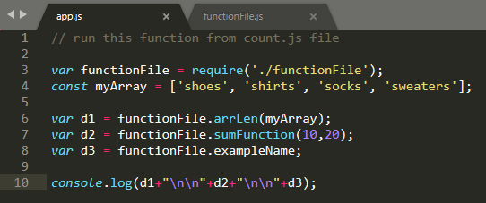
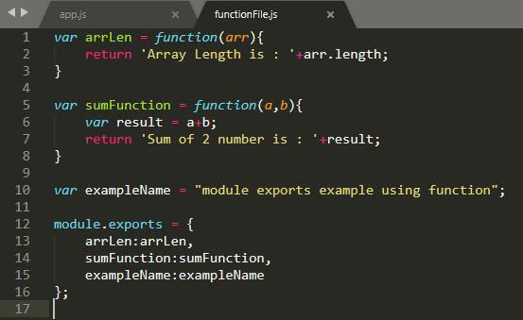
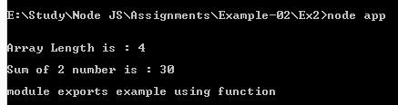
Example - 02
--------------------------------
Require Use Multi User Define Function

Slide 10
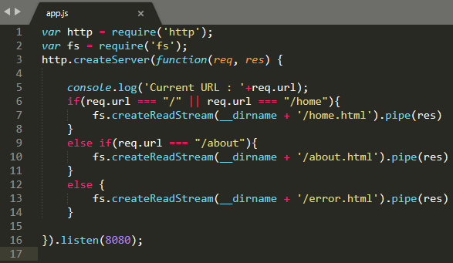
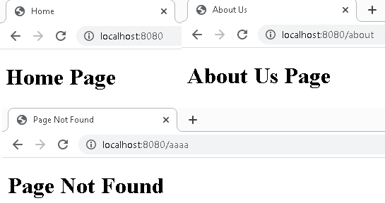
Simple Page Navigation HTML Pages

Slide 12
// read json
var student = {
name: 'Mike',
age: 23,
gender: 'Male',
department: 'English',
car: 'Honda'
};
var data = JSON.stringify(student);
console.log(data);

